Slide 1
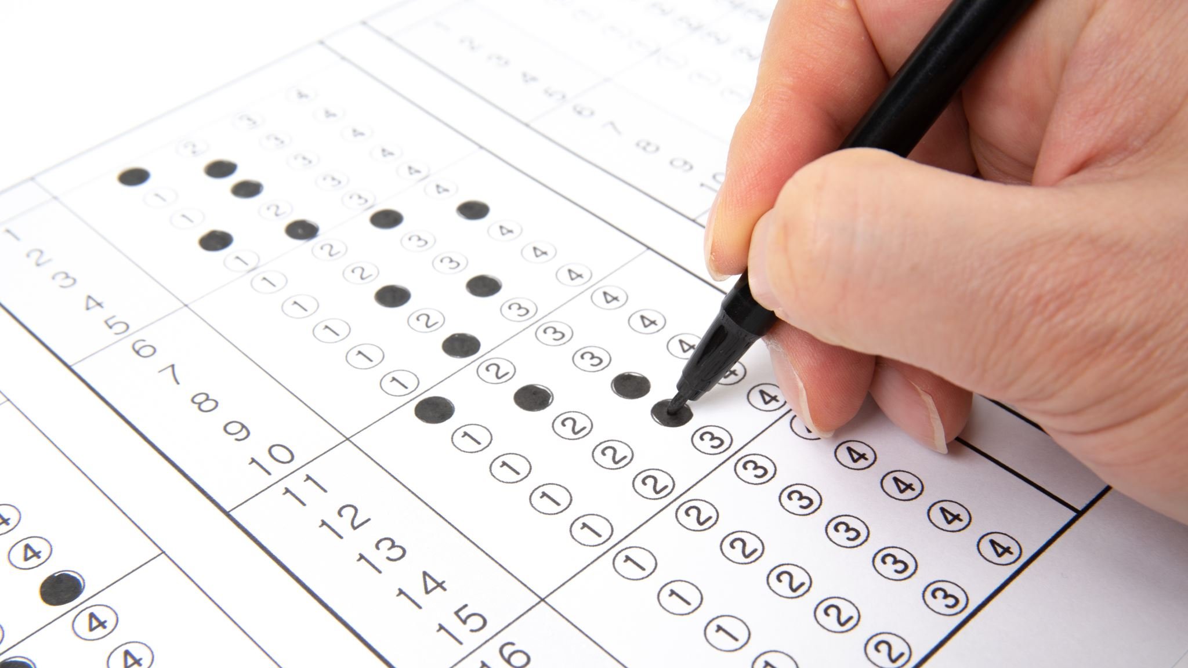
Smart Voting System
Members: Guidance By:
22 Utkarsh Khandare DR. Arvind Jagtap
24 Rohit Dhotre
25 Vaibhav Barawkar
31 Yashraj Devrat
38 Shreyas Kulkarni

Slide 2

CONTENTS:
Objectives
Problem Statement
Introduction
Need of Project
Steep Analysis
Empathy Map
Customer Journey Map
WH Questions
Conclusion

Slide 3
OBJECTIVES
TO BOOST THE VOTING SPEED USING ONLINE SECURE WEBSITE
MINIMIZES VOTE COUNTING MISTAKES
TO REDUCES FAKE VOTING
MAXIMIZES PARTICIPATION FOR VOTING

Slide 4

PROBLEM STATEMENT
Many problems are faced by the people in voting manually :-
Much time is required.
As it has been observed that in some cases booth capturing has been reported.
Reduces the chances of conflicts.
Reduces the time for ballot counting and many others.

Slide 5
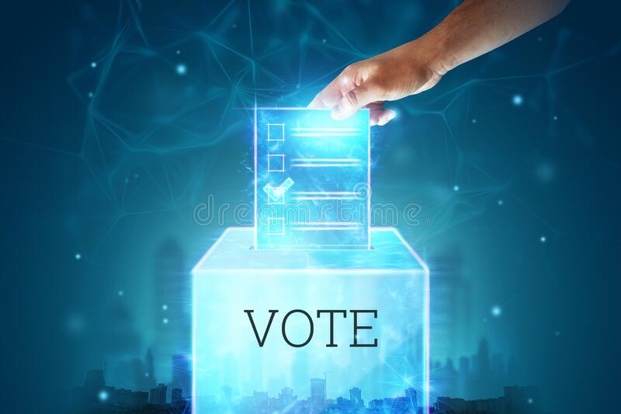
INTRODUCTION:
Online Voting System is an online voting technique.
In this system people who have citizenship of a country and whose age is above 18 years of any sex can give his/her vote online without going to any polling booth.
There is a database which is maintained by the Electoral Commission in which all the names of voter with complete information is stored.

Slide 6
NEED OF PROJECT :
Vote at any time from anywhere
Boost participation
Less physical infrastructure
More rich ballots
Fast and easy votes tally

Slide 7
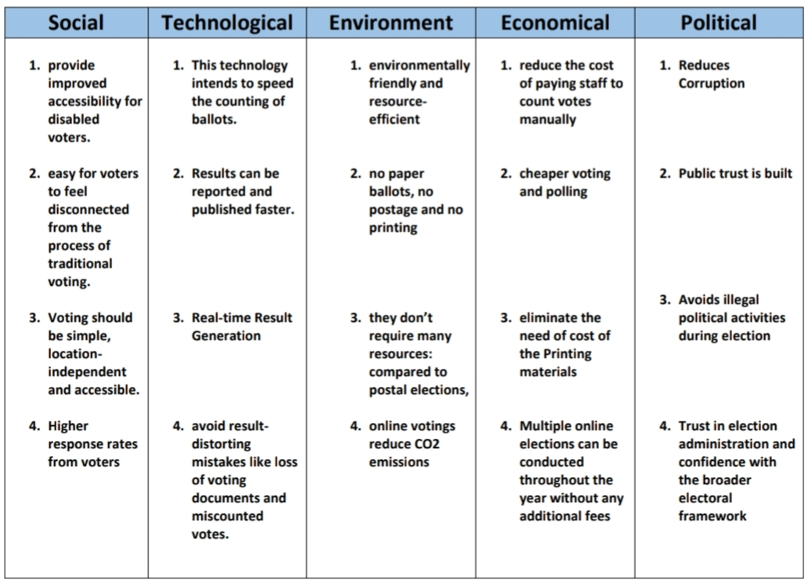
STEEP ANALYSIS

Slide 8
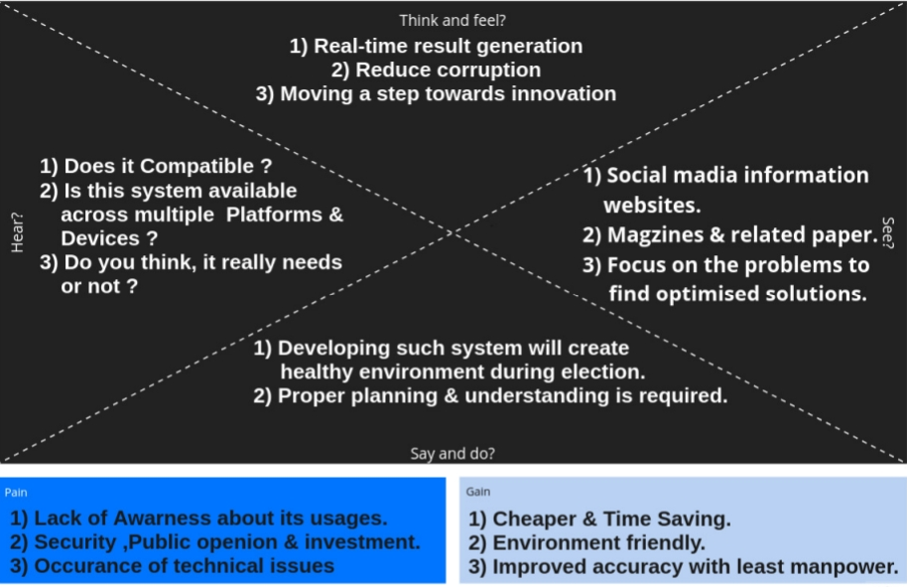
EMPATHY MAP:

Slide 9
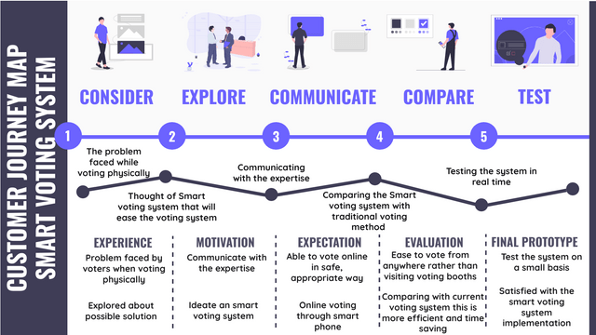
CUSTOMER JOURNEY MAP

Slide 10
5 WH QUESTIONS:
What is the need for this system?
Does the software offer great customer support?
How many people will be using the system?
When did you realise the issue with existing system?
Is the software easy to use?

Slide 11
CONCLUSION
This Online Voting system will manage the Voter's information by which voter can login and use his voting rights.
The system will incorporate all features of Voting system.
It’s provide the tools for maintaining voter's vote to every party and it count total number of votes of every party.
There is a DATABASE which is maintained by the electoral commission in which all the names of voter with complete information is stored.

Slide 12
THANK YOU

